Slide 1
Web and Network Security: Network Attacks and Defenses CS-4440 - Introduction to Computer Security Spring 2022 Jun Xu Slides adapted from 15-441 by Justin Weisz at CMU

Slide 2
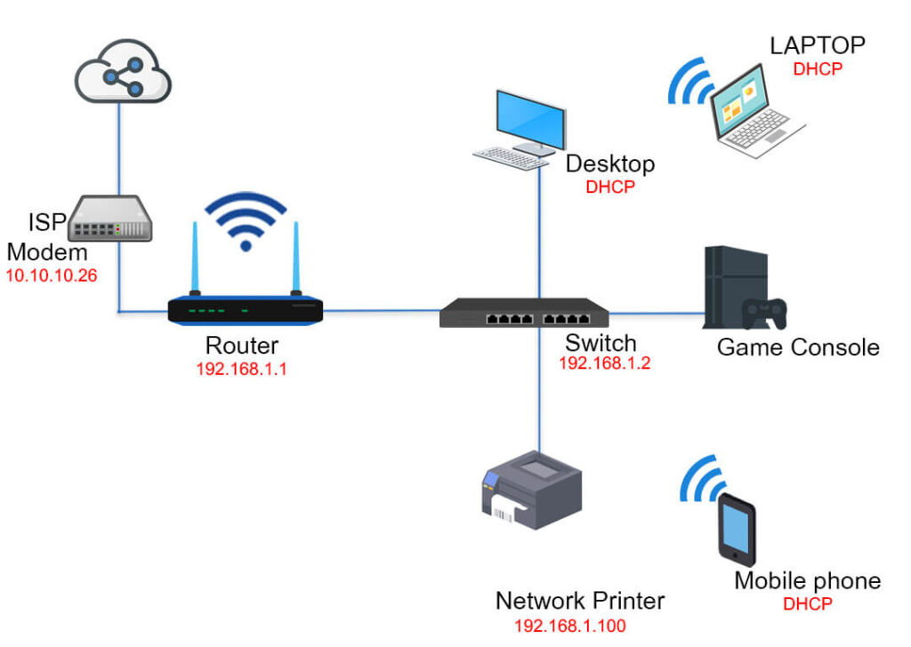
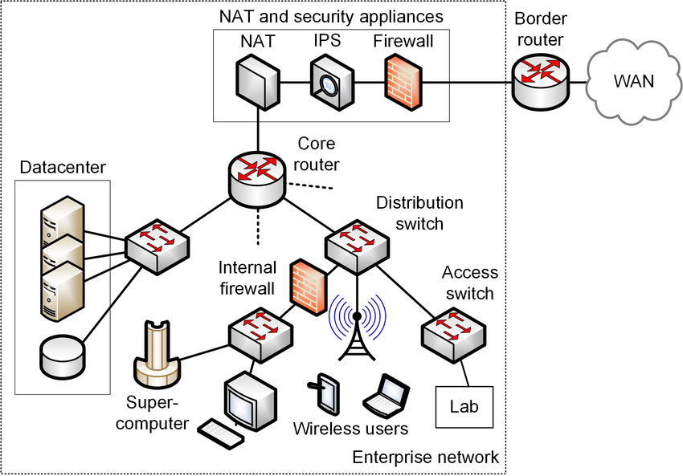
Common Network Topology
Home Network
Enterprise Network

Slide 3
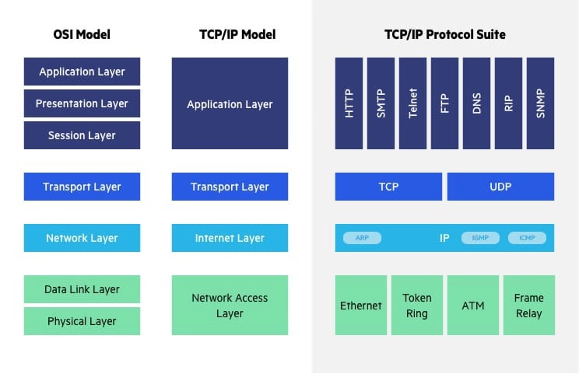
How Much Do You Know About Network Layers?

Slide 4
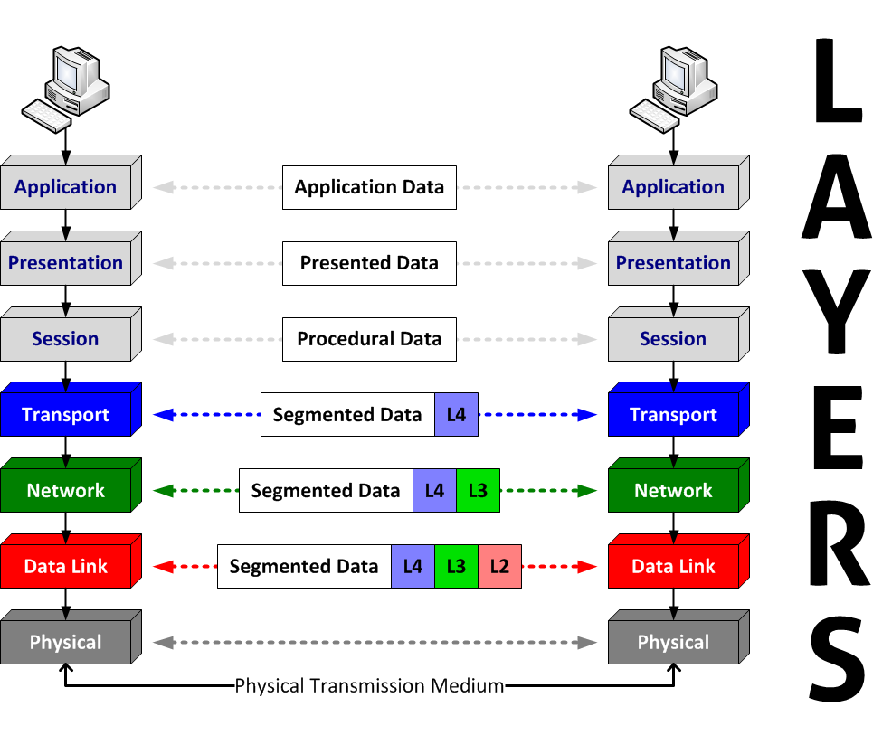
How the OSI Layers Work?
HTTP,
FTP,
DNS
TCP, UDP
IP
MAC

Slide 5
Example of A Complete HTTP Packet
MAC: 00:00:5e:00:53:af
IP: 10.0.0.1
TCP: Src Port; Dest Port; …
GET /hello.html HTTP/1.1
Contents
Data Link Layer
MAC Address (Typically used by the Switch)
Network Layer
IP Header (Typically used by the Router)
Transport Layer
TCP Header (Typically used by the OS kernel)
Application Layer:
HTTP Header (Used by your application)
Your Data (Used by you)
Physical Layer: Common Example: OTN Protocol (used by, for example, optical fiber)
-- OTN is a digital wrapper that encapsulates frames of data, to allow multiple data sources to be sent on the same channel. This creates an optical virtual private network for each client signal.

Slide 6
Now Let’s Talk about Security
Hope I have done enough preparations ☺
Let’s talk about attacks from the lower level to the higher level

Slide 7
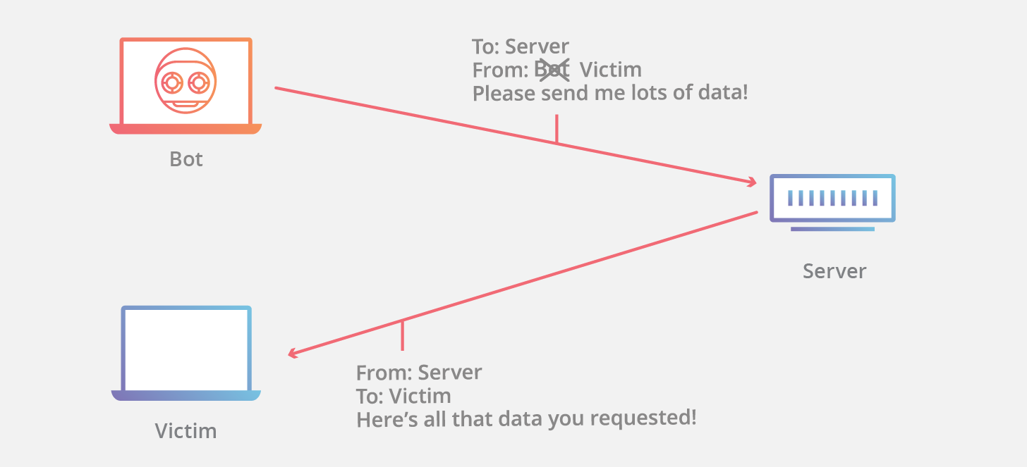
IP Spoofing
IP spoofing is the creation of IP packets which have a modified source address in order to hide the identity of the sender

Slide 8
Why IP Spoofing Possible
How IP works…
End hosts create IP packets and routers process them purely based on destination address alone
Problem: End hosts may lie about other fields which do not affect delivery
Source address – host may trick destination into believing that the packet is from a trusted source
Especially applications which use IP addresses as a simple authentication method
Mitigation – use better authentication methods

Slide 9
Why It Matters?
What can the adversaries do by leveraging IP spoofing?
Denial-of-Service

Slide 10
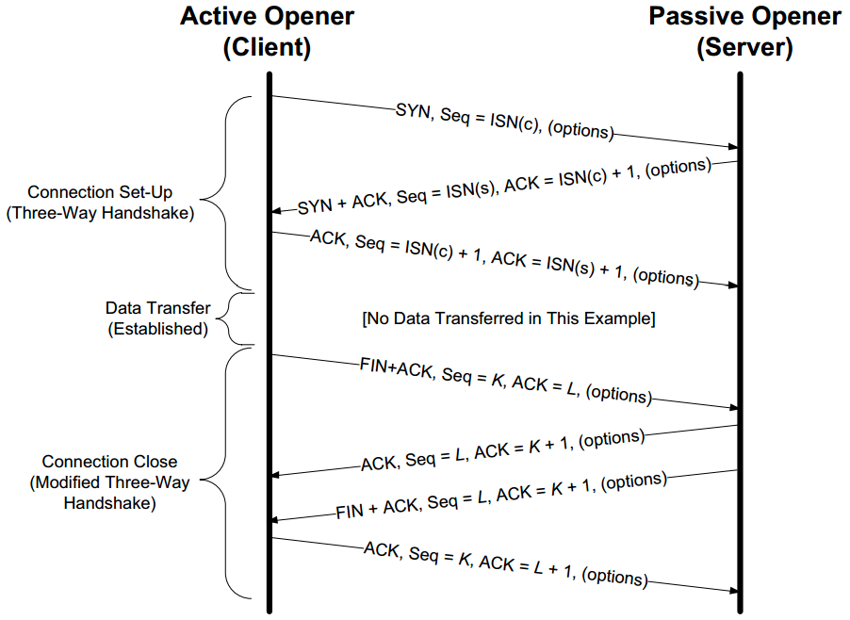
TCP Hijacking

Slide 11
TCP Hijacking
TCP connections have associated state
Starting sequence numbers, port numbers
Problem – what if an attacker learns these values?
Port numbers are sometimes well known to begin with (e.g., HTTP uses port 80)
Sequence numbers are sometimes chosen in very predictable ways

Slide 12
TCP Hijacking
If an attacker learns the associated TCP state for the connection, then the connection can be hijacked!
Attacker can insert malicious data into the TCP stream, and the recipient will believe it came from the original source
E.g., Instead of downloading and running new program, you download a virus and execute it

Slide 13



TCP Hijacking
Say hello to Alice, Bob and Mr. Big Ears

Slide 14
TCP Hijacking
Alice and Bob have an established TCP connection

Slide 15
TCP Hijacking
Mr. Big Ears lies on the path between Alice and Bob on the network
He can intercept all their packets

Slide 16
TCP Hijacking
First, Mr. Big Ears must drop all of Alice’s packets since they must not be delivered to Bob (why?)
Packets
The Void
Notes:
Alice can send a RESET

Slide 17
TCP Hijacking
Then, Mr. Big Ears sends his malicious packet with the next ISN (sniffed from the network)
ISN, SRC=Alice

Slide 18
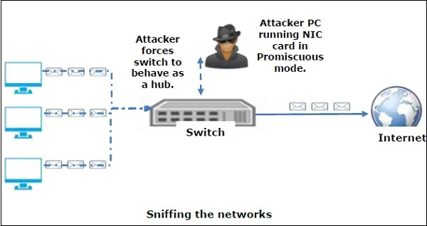
Packet Sniffing

Slide 19
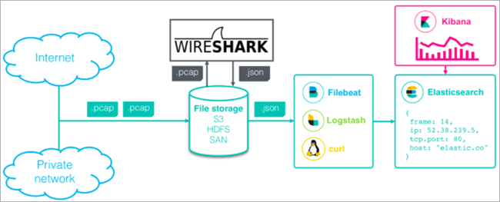
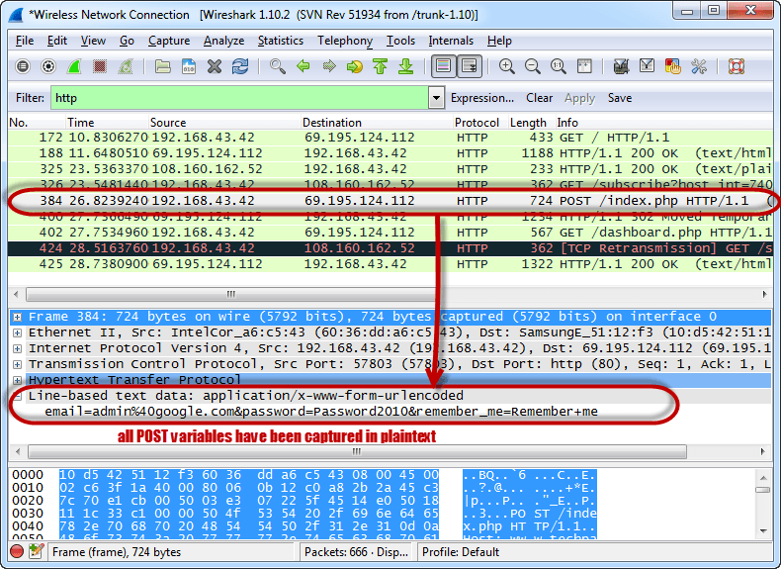
Packet Sniffing

Slide 20

Denial of Service
Purpose: Make a network service unusable, usually by overloading the server or network
Many different kinds of DoS attacks
SYN flooding
SMURF
Distributed attacks
Case Study: Code-Red

Slide 21
Denial of Service
SYN flooding attack
Send SYN packets with bogus source address
Why?
Server responds with SYN ACK and keeps state about TCP half-open connection
Eventually, server memory is exhausted with this state
Solution: use “SYN cookies”
In response to a SYN, create a special “cookie” for the connection, and forget everything else
Then, can recreate the forgotten information when the ACK comes in from a legitimate connection
Notes:
Forge source IP so that the victim can’t figure out who you are.

Slide 22
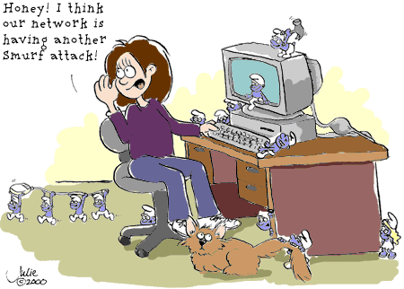
Denial of Service

Slide 23
Denial of Service
SMURF
Source IP address of a broadcast ping is forged
Large number of machines respond back to victim, overloading it

Slide 24
Distributed Denial of Service
Distributed Denial of Service
Same techniques as regular DoS, but on a much larger scale
Example: Sub7Server Trojan and IRC bots
Infect a large number of machines with a “zombie” program
Zombie program logs into an IRC channel and awaits commands
Example:
Bot command: !p4 207.71.92.193
Result: runs ping.exe 207.71.92.193 -l 65500 -n 10000
Sends 10,000 64k packets to the host (655MB!)
Read more at: http://grc.com/dos/grcdos.htm

Slide 25
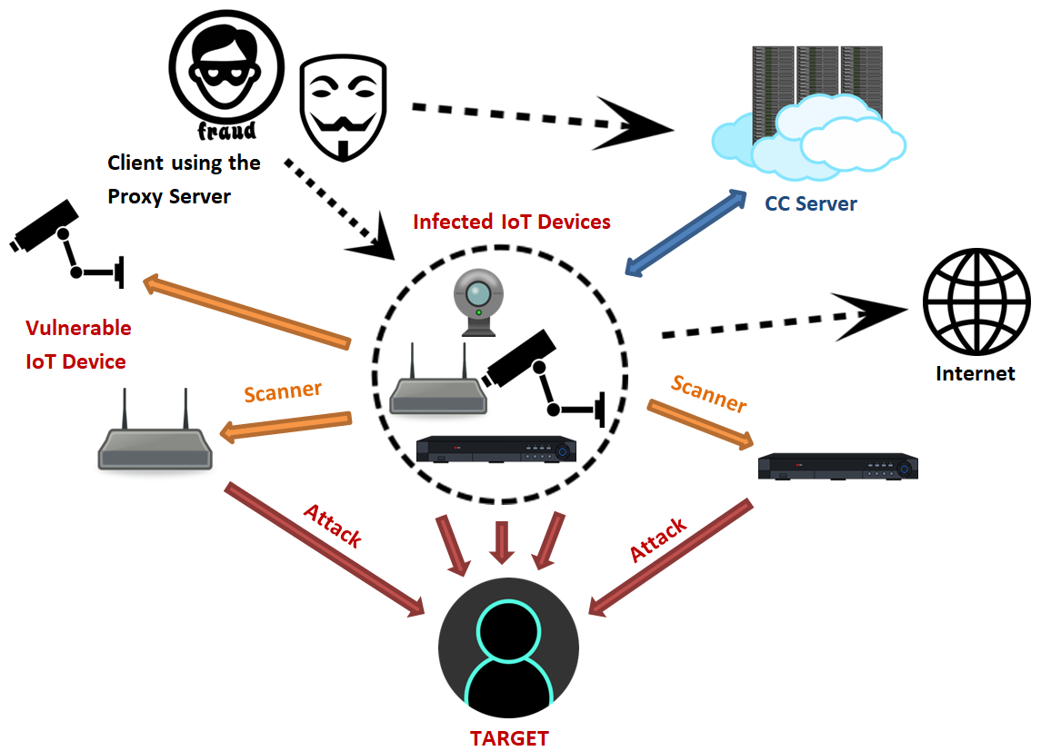
The Mirai Attack
On 21 October 2016, multiple major DDoS attacks in DNS services of DNS service provider Dyn occurred using Mirai malware installed on a large number of IoT devices, many of which were still using their default usernames and passwords. These attacks resulted in the inaccessibility of several high-profile websites, including GitHub, Twitter, Reddit, Netflix, Airbnb and many others. The attribution of the Dyn attack to the Mirai botnet was originally reported by Level 3 Communications
-- https://en.wikipedia.org/wiki/Mirai_(malware)

Slide 26

Related: Dictionary Attack
We can run a dictionary attack on the passwords
The passwords in /etc/passwd are encrypted with the crypt(3) function (one-way hash)
Can take a dictionary of words, crypt() them all, and compare with the hashed passwords
This is why your passwords should be meaningless random junk!
For example, “sdfo839f” is a good password
That is not my andrew password
Please don’t try it either

Slide 27
Denial of Service
Mini Case Study – CodeRed
July 19, 2001: over 359,000 computers infected with Code-Red in less than 14 hours
Used a recently known buffer exploit in Microsoft IIS
Damages estimated in excess of $2.6 billion

Slide 28
Software Vulnerabilities
int target(int arg) { … }
int entry(void){
int (*fptr)(int);
…
char buffer[128];
fptr = target;
gets(buffer);//Read over 128 bytes
child(fptr);
return 0;
}
void child(int (*fptr)(int)){
fptr(1);
}
Example – Simplified CVE-2013-2028
Buffer Overflow

Slide 29
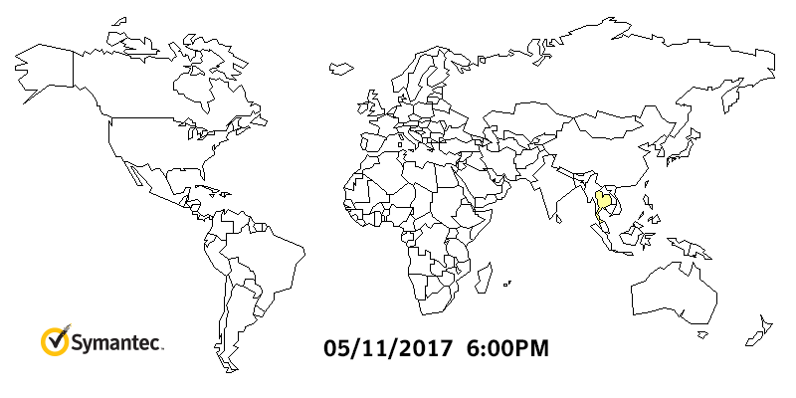
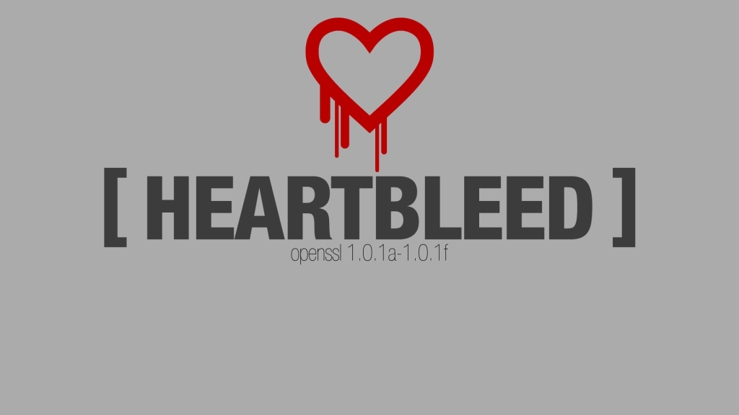
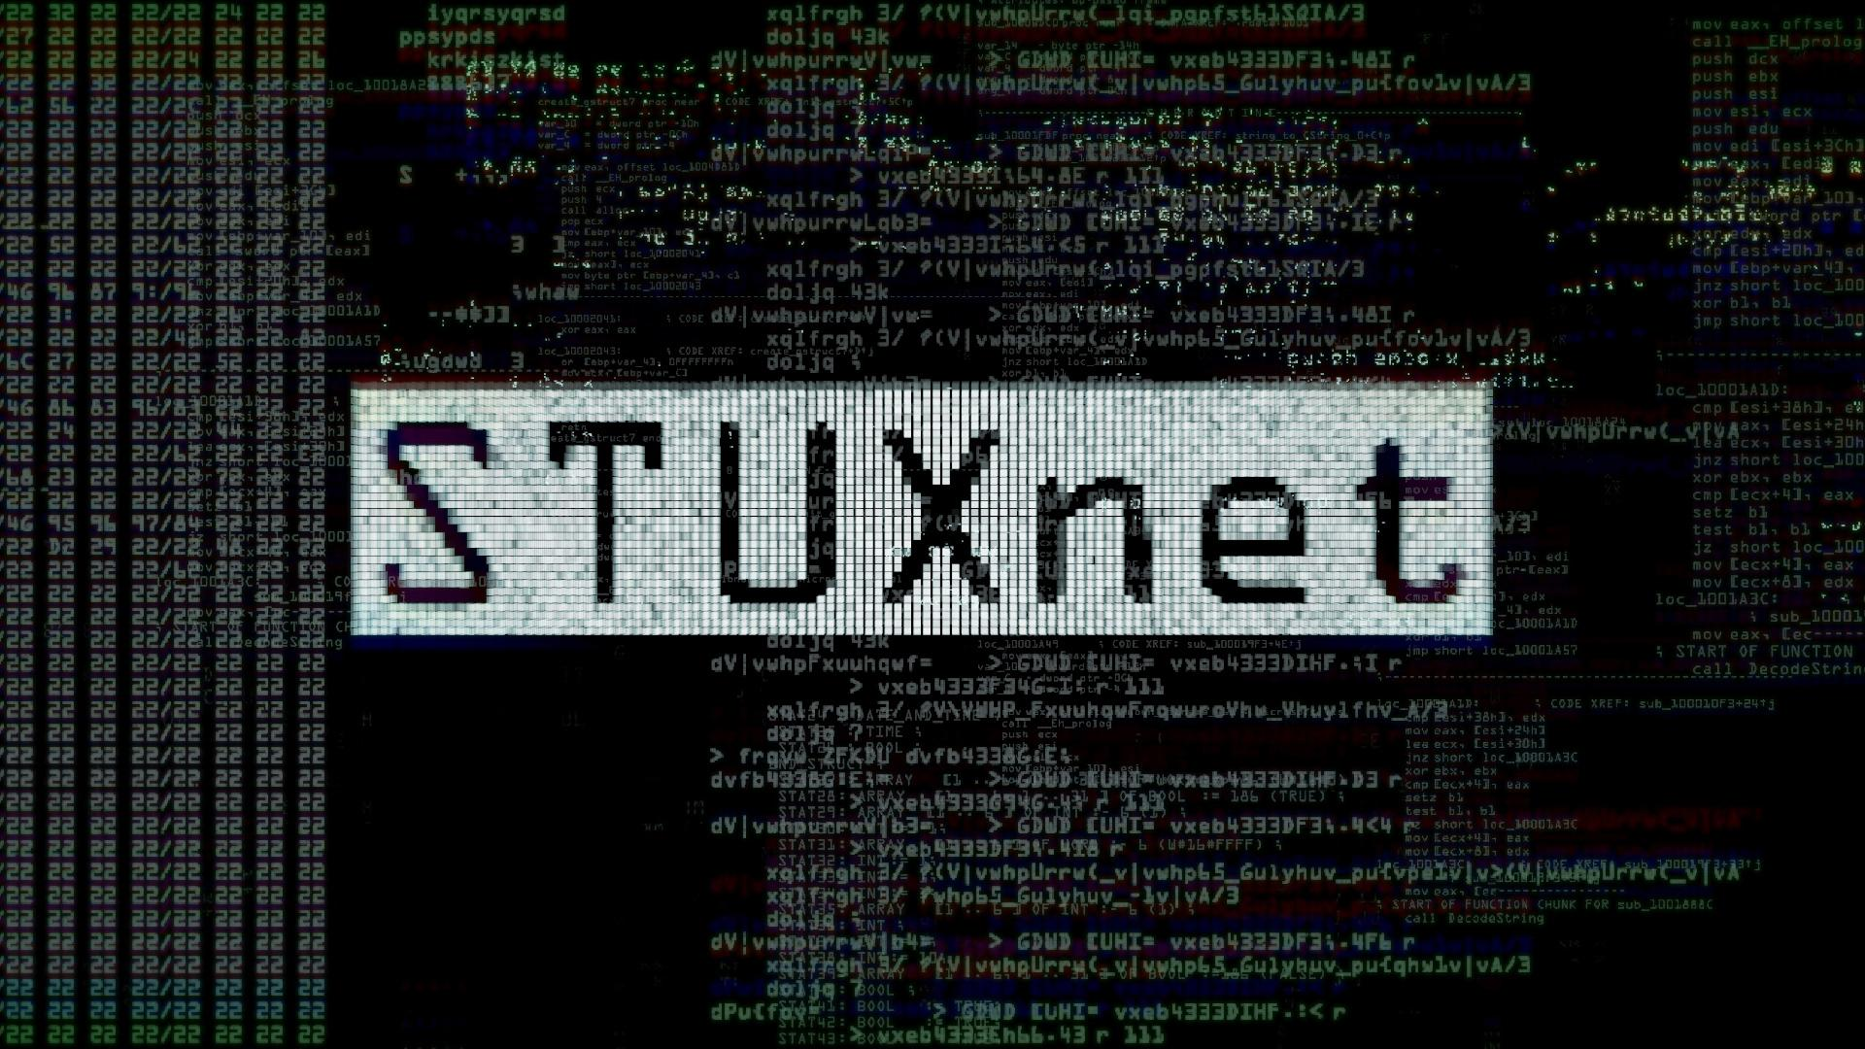
WannaCry Ransomware Attack
48 hours
230K machines
150 countries
4 billion USD
Ref https://www.symantec.com/blogs/threat-intelligence/wannacry-ransomware-attack

Slide 30
What Can We Do for Protection

Slide 31
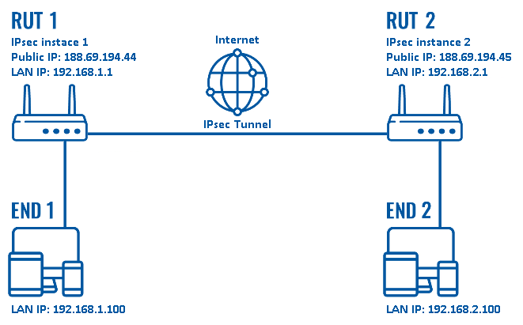
Secure Communications
SSH: Application Layer Secure Communications
SSL/TLS: Transport Layer Secure Communications
IPSEC: Internet Layer Secure Communications

Slide 32
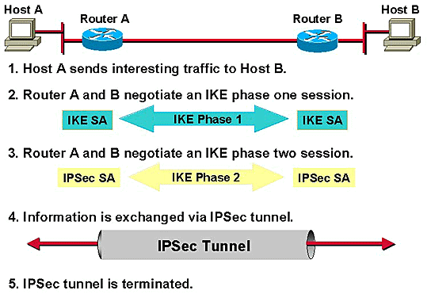
IPSEC
IPsec uses cryptographic security services to protect communications over Internet Protocol (IP) networks. It supports network-level peer authentication, data origin authentication, data integrity, data confidentiality (encryption), and replay protection.

Slide 33
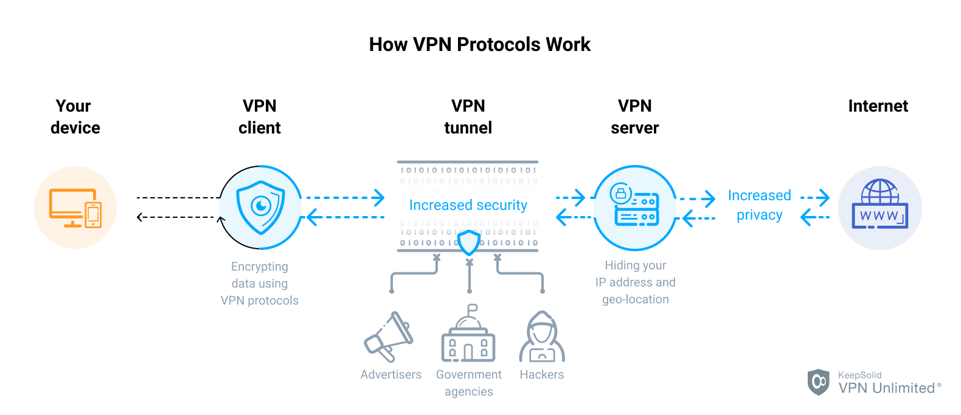
VPN
Build on top of IPSEC or SSL

Slide 34

Firewalls
Basic problem – many network applications and protocols have security problems that are fixed over time
Difficult for users to keep up with changes and keep host secure
Solution
Administrators limit access to end hosts by using a firewall
Firewall is kept up-to-date by administrators

Slide 35
Firewalls
A firewall is like a castle with a drawbridge
Only one point of access into the network
This can be good or bad
Can be hardware or software
Ex. Some routers come with firewall functionality
ipfw, ipchains, pf on Unix systems, Windows XP and Mac OS X have built in firewalls
Notes:
Why good? Because it lets you filter what comes in and what goes out.
Why bad? If that point goes down, you are cut off from everyone else. Also, may have lots of congestion at that one point.

Slide 36
Firewalls
Internet
DMZ
Web server, email server, web proxy, etc
Firewall
Firewall
Intranet

Slide 37
Firewalls
Used to filter packets based on a combination of features
These are called packet filtering firewalls
There are other types too, but they will not be discussed
E.g., Drop packets with destination port of 23 (Telnet)
Can use any combination of IP/UDP/TCP header information
man ipfw on unix47 for much more detail
But why don’t we just turn Telnet off?

Slide 38
Firewalls
What does a firewall rule look like?
Depends on the firewall used
Example: ipfw
/sbin/ipfw add deny tcp from cracker.evil.org to wolf.tambov.su telnet
Other examples: WinXP & Mac OS X have built in and third party firewalls
Different graphical user interfaces
Varying amounts of complexity and power

Slide 39
Firewalls
Here is what a computer with a default Windows XP install looks like:
135/tcp open loc-srv
139/tcp open netbios-ssn
445/tcp open microsoft-ds
1025/tcp open NFS-or-IIS
3389/tcp open ms-term-serv
5000/tcp open UPnP
Might need some of these services, or might not be able to control all the machines on the network

Slide 40

Intrusion Detection
Used to monitor for “suspicious activity” on a network
Can protect against known software exploits, like buffer overflows
Open Source IDS: Snort, www.snort.org

Slide 41
Intrusion Detection
Uses “intrusion signatures”
Well known patterns of behavior
Ping sweeps, port scanning, web server indexing, OS fingerprinting, DoS attempts, etc.
Example
IRIX vulnerability in webdist.cgi
Can make a rule to drop packets containing the line
“/cgi-bin/webdist.cgi?distloc=?;cat%20/etc/passwd”
However, IDS is only useful if contingency plans are in place to curb attacks as they are occurring

Slide 42
Application to Denial of Service
How can we protect ourselves?
Ingress filtering
If the source IP of a packet comes in on an interface which does not have a route to that packet, then drop it
RFC 2267 has more information about this
Stay on top of CERT advisories and the latest security patches
A fix for the IIS buffer overflow was released sixteen days before CodeRed had been deployed!

